Slide 1
University Admission System
Course: ITCS 6112
Team:
Susritha Baditha 800876039
Sharath Chandrika Mummoju 800965107
Raghava Adarsh Mandarapu 800937296
Virinchi Ande 800970447
Likhith Chinnam 800986749
Puneeth Devabhaktuni 800953156
Aditya Viswanadha 800959537

Slide 2
Flow of Our Presentation
Introduction
Block Diagram
Process
Approach
Component Diagram
Model View of Control Diagram
Architecture
Sequence Diagram
Use Case Diagram
Class Diagram
Deployment Diagram
Walk Through of the project
Tools Used
Testing
Challenges
Conclusion
Future Scope

Slide 3
What Does a Web Application Contain?

Slide 4
What does a Web Application Contain?
Web Application
User
Web Browser
Internet Connection
Web
Server
Database Server
Database

Slide 5
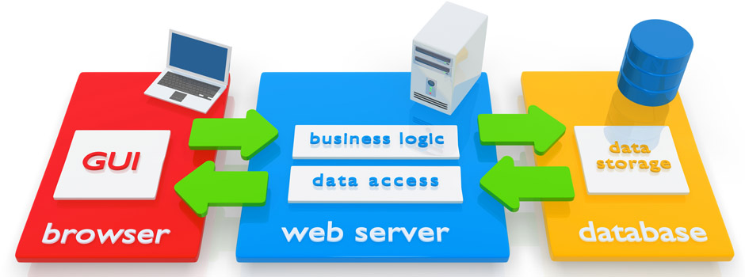
Block Diagram

Slide 6

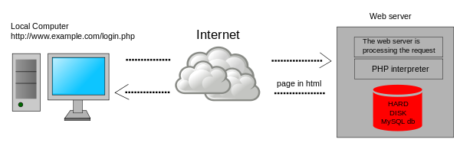
The “Process”

Slide 7
The “Approach”
Servlet/JSP
Low Level API
High degree of control over HTML, CSS, Java Script
JSF
Higher level API
Spring Framework
Higher API.
Higher degree of control over HTML, CSS, JS
Lower degree of control over HTML, CSS, Java Script

Slide 8
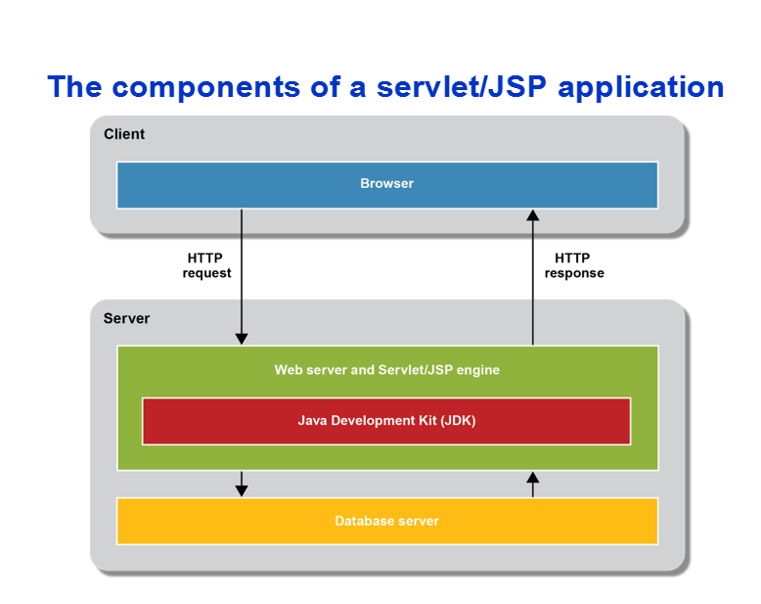
Components of Servlet/ JSP

Slide 9
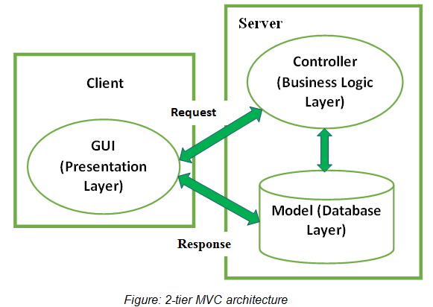
Model View Control Architecture

Slide 10
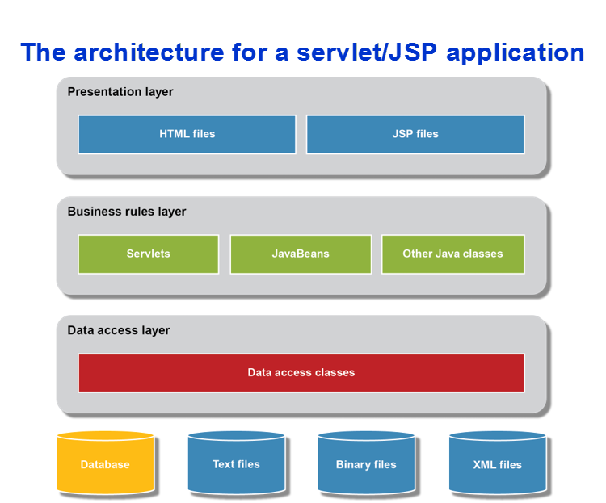
Architecture of Servlet/JSP

Slide 11
Software Engineering Model Used: “Incremental Model”
Produce a rough initial version first with only some features
Get feedback
Refine and improve software; Each increment provides part of functionality
+ Strives to overcome Waterfall and Iterative models
+ Can accommodate changes
+ Rapid development and delivery of useful software to the customer

Slide 12
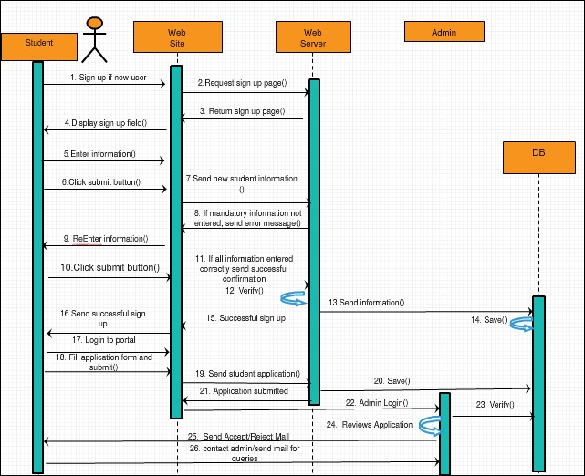
Sequence Diagram

Slide 13
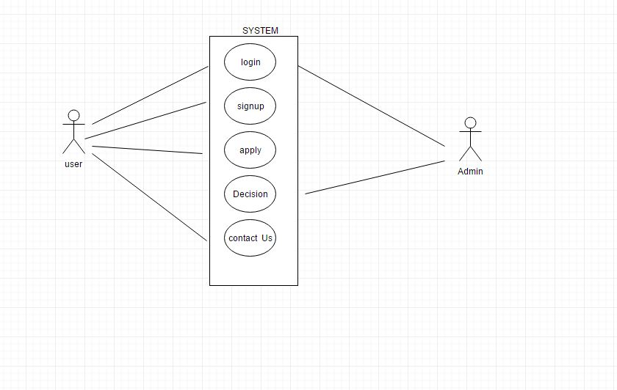
Use Case Diagram

Slide 14
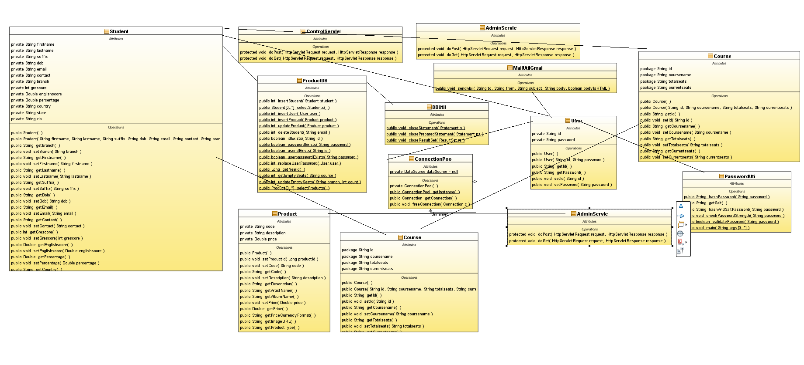
Class Diagram

Slide 15
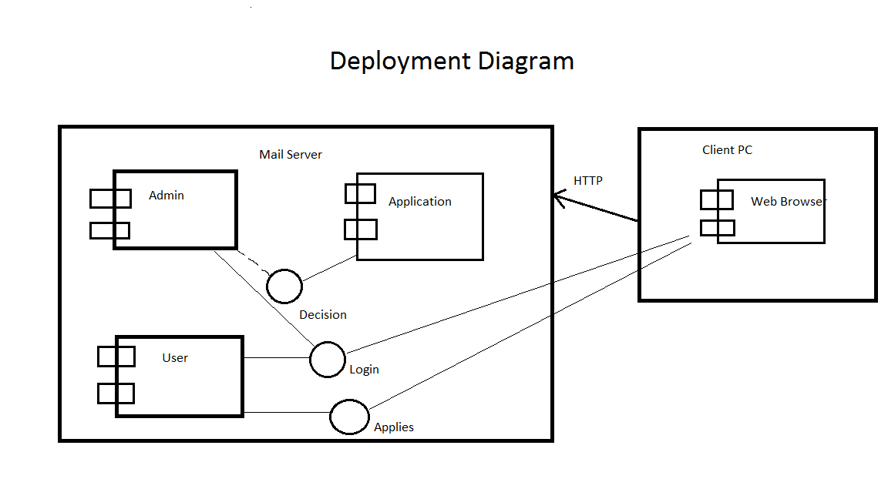
Deployment Diagram

Slide 16
A Walkthrough of the Project
Home Page
Login/Signup
About Us
Contact Us
Image Gallery

Slide 17
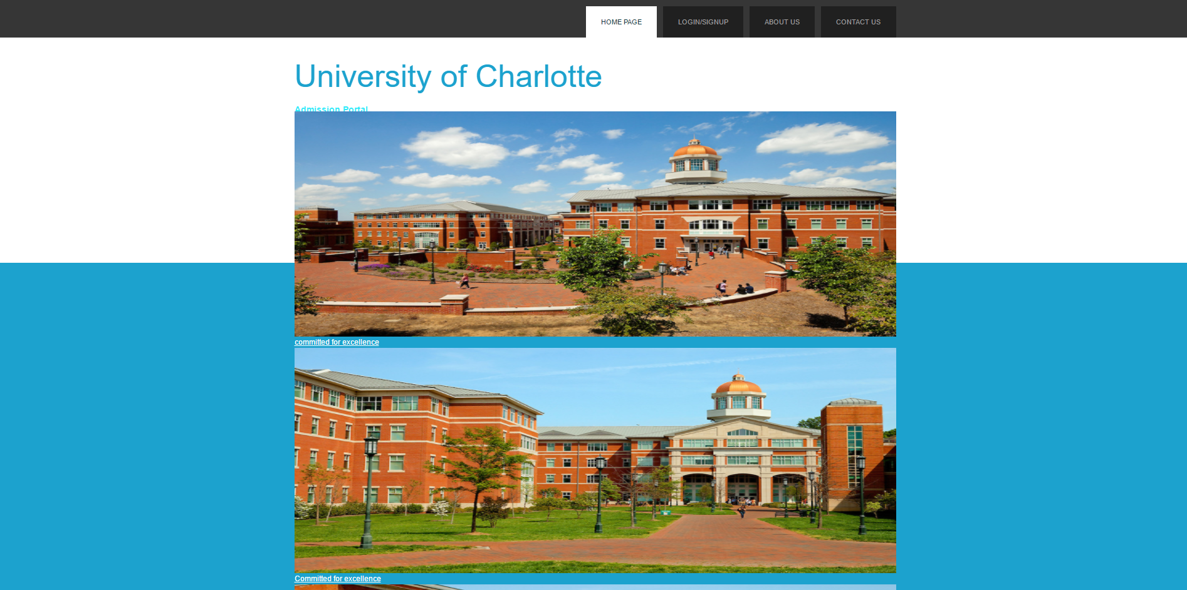
Home Page

Slide 18
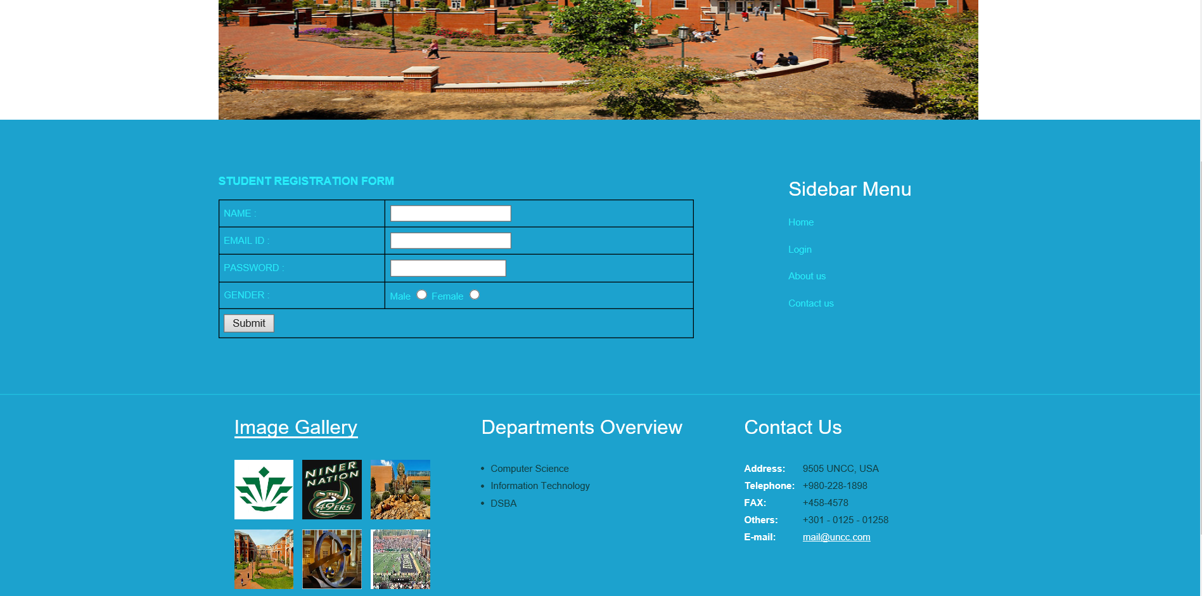
Login/ Signup

Slide 19
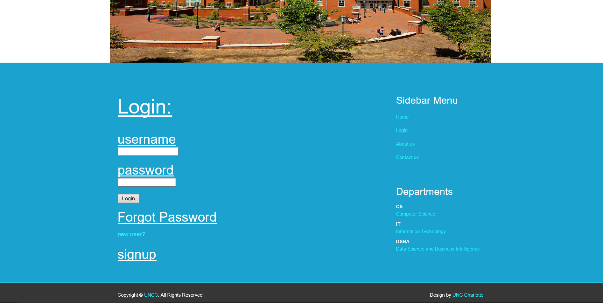
Sign In Page

Slide 20
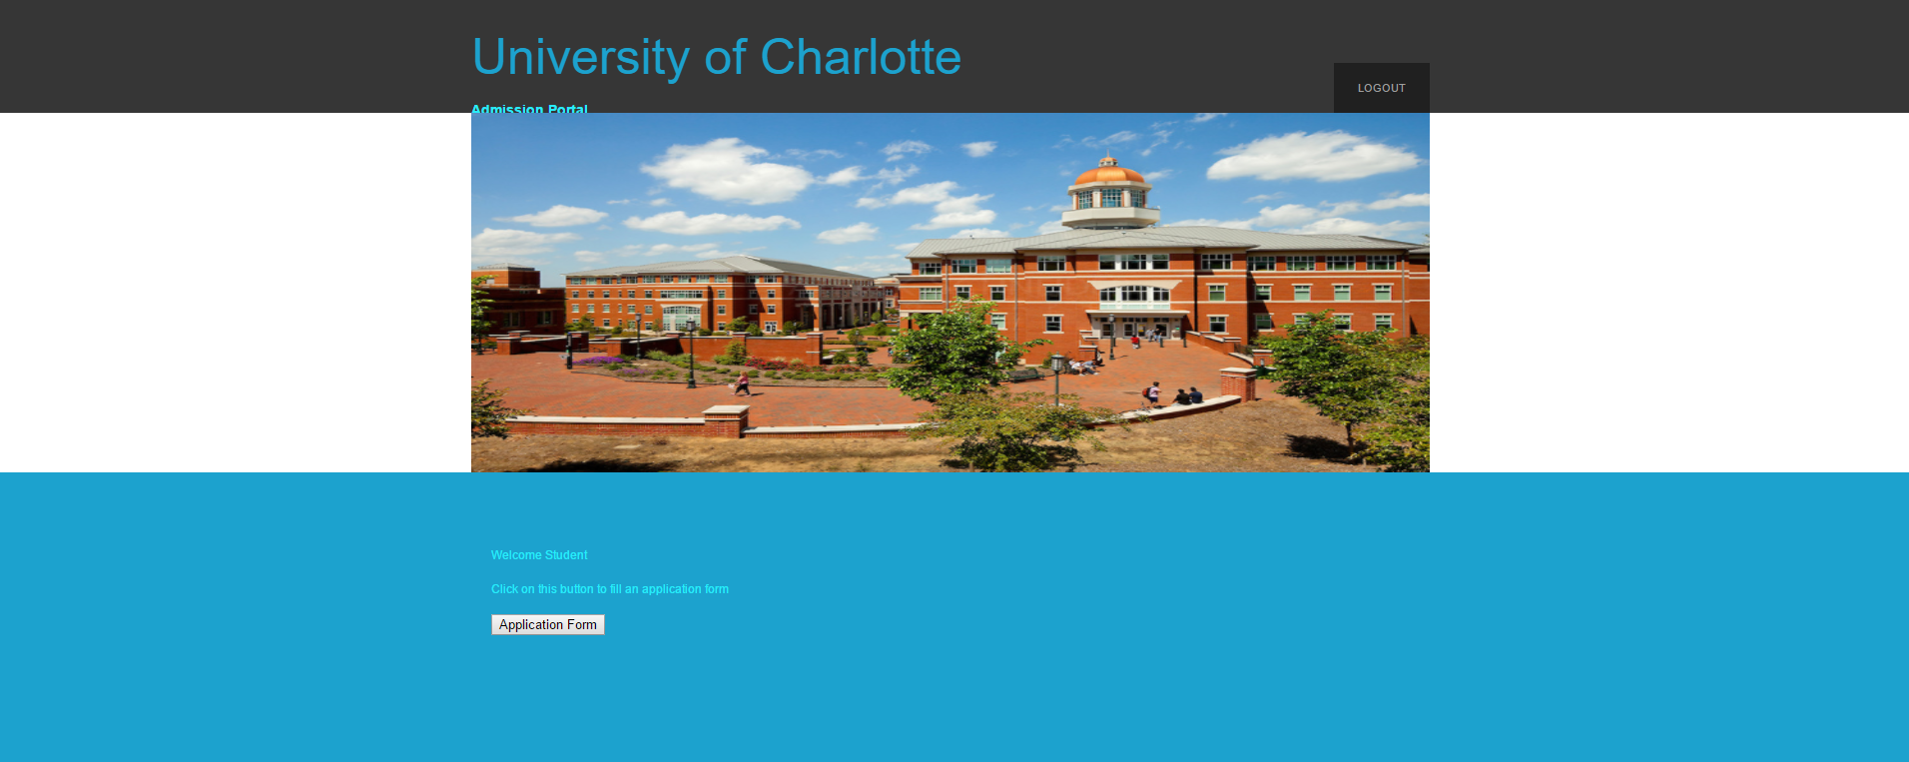
Student Home Page

Slide 21
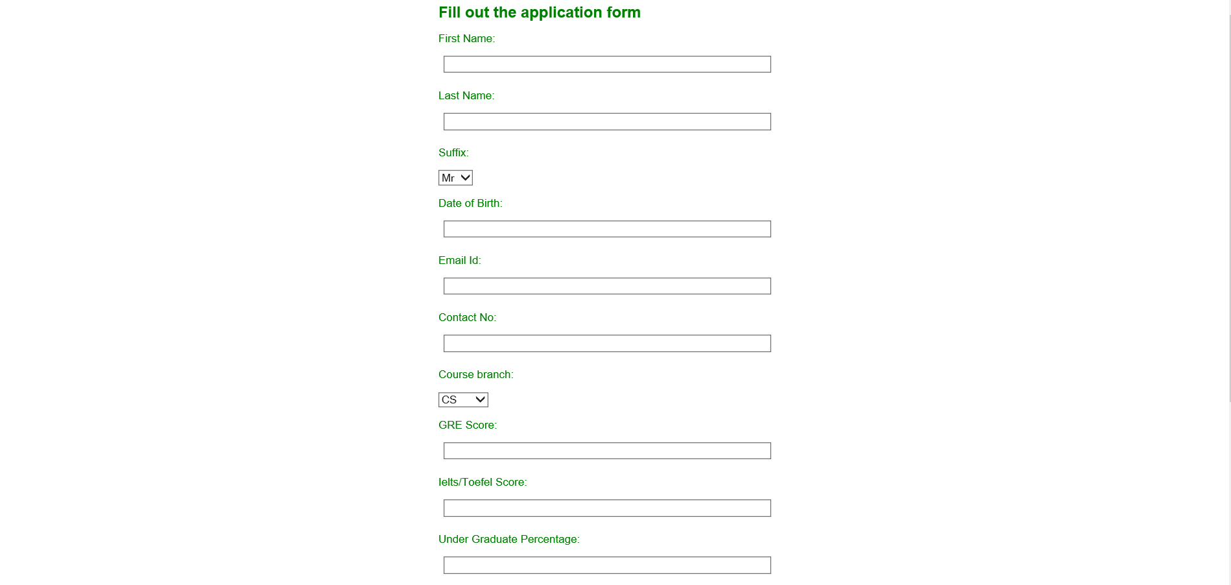
Application Page

Slide 22

Application is Not Easy Right?

Slide 23
Admin Login

Slide 24
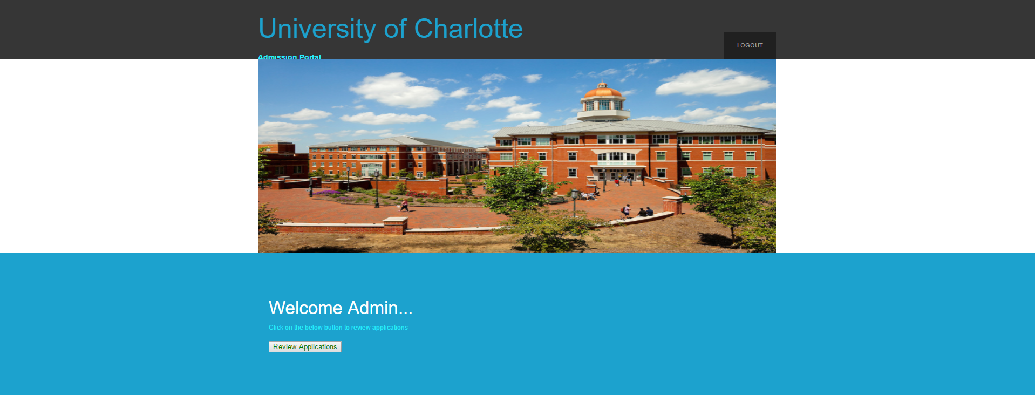
Admin Functionalities

Slide 25

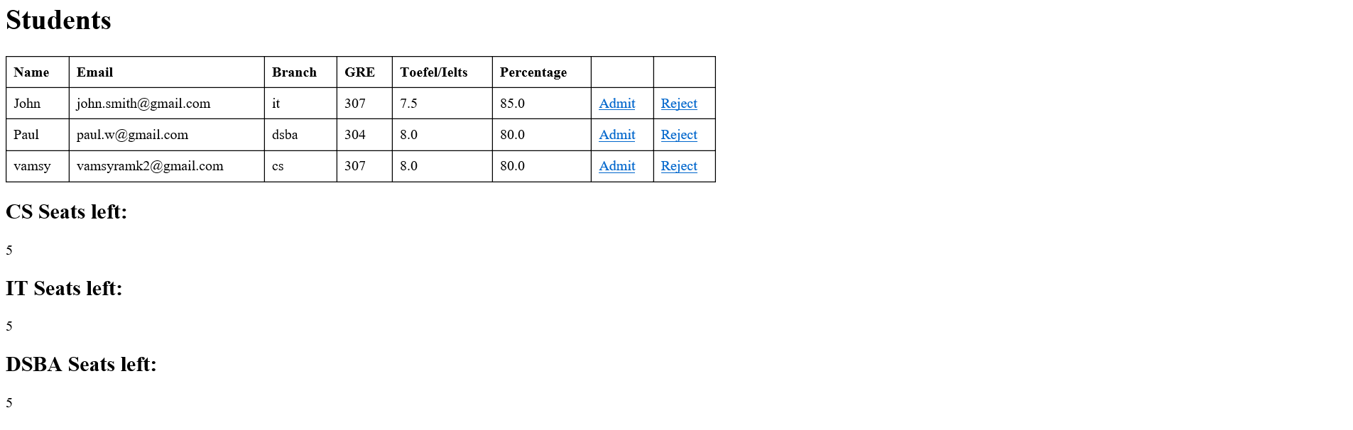
Make a Decision

Slide 26

Tools/ Languages Used
Languages
Java
MySQL
Tools/ IDE
NetBeans/ Tomcat
MySQL Workbench

Slide 27

Testing
We used Dynamic Testing for the development of the project.
Project executed in batch wise and errors/ malfunctions are rectified.
Can be performed at various scopes.
We used for both verification and validation.

Slide 28
Challenges
Creating the cross-reference teams is the main issue
. Independently each team is perfect. Cross reference teams rely on other teams for their functioning. Even if one team is working fine, they might be slowed down because of other teams.
So, to use agile methodology on a large scale and to make it work, proper pre-planning has to be devised and project teams with similarities have to be selected who can work in collaborative environment.
Reference: Scaling Agile: Finding your Agile Tribe by Erik Moore: John Spens

Slide 29

Conclusion
University admission application is designed.
It is tested within our constraints and the code has executed successfully.

Slide 30
Future Scope
Higher level hashing and Salting user passwords.
More details in the application form.
Including more departments.
Make a universal application like canvas.

Slide 31


